Slide 1
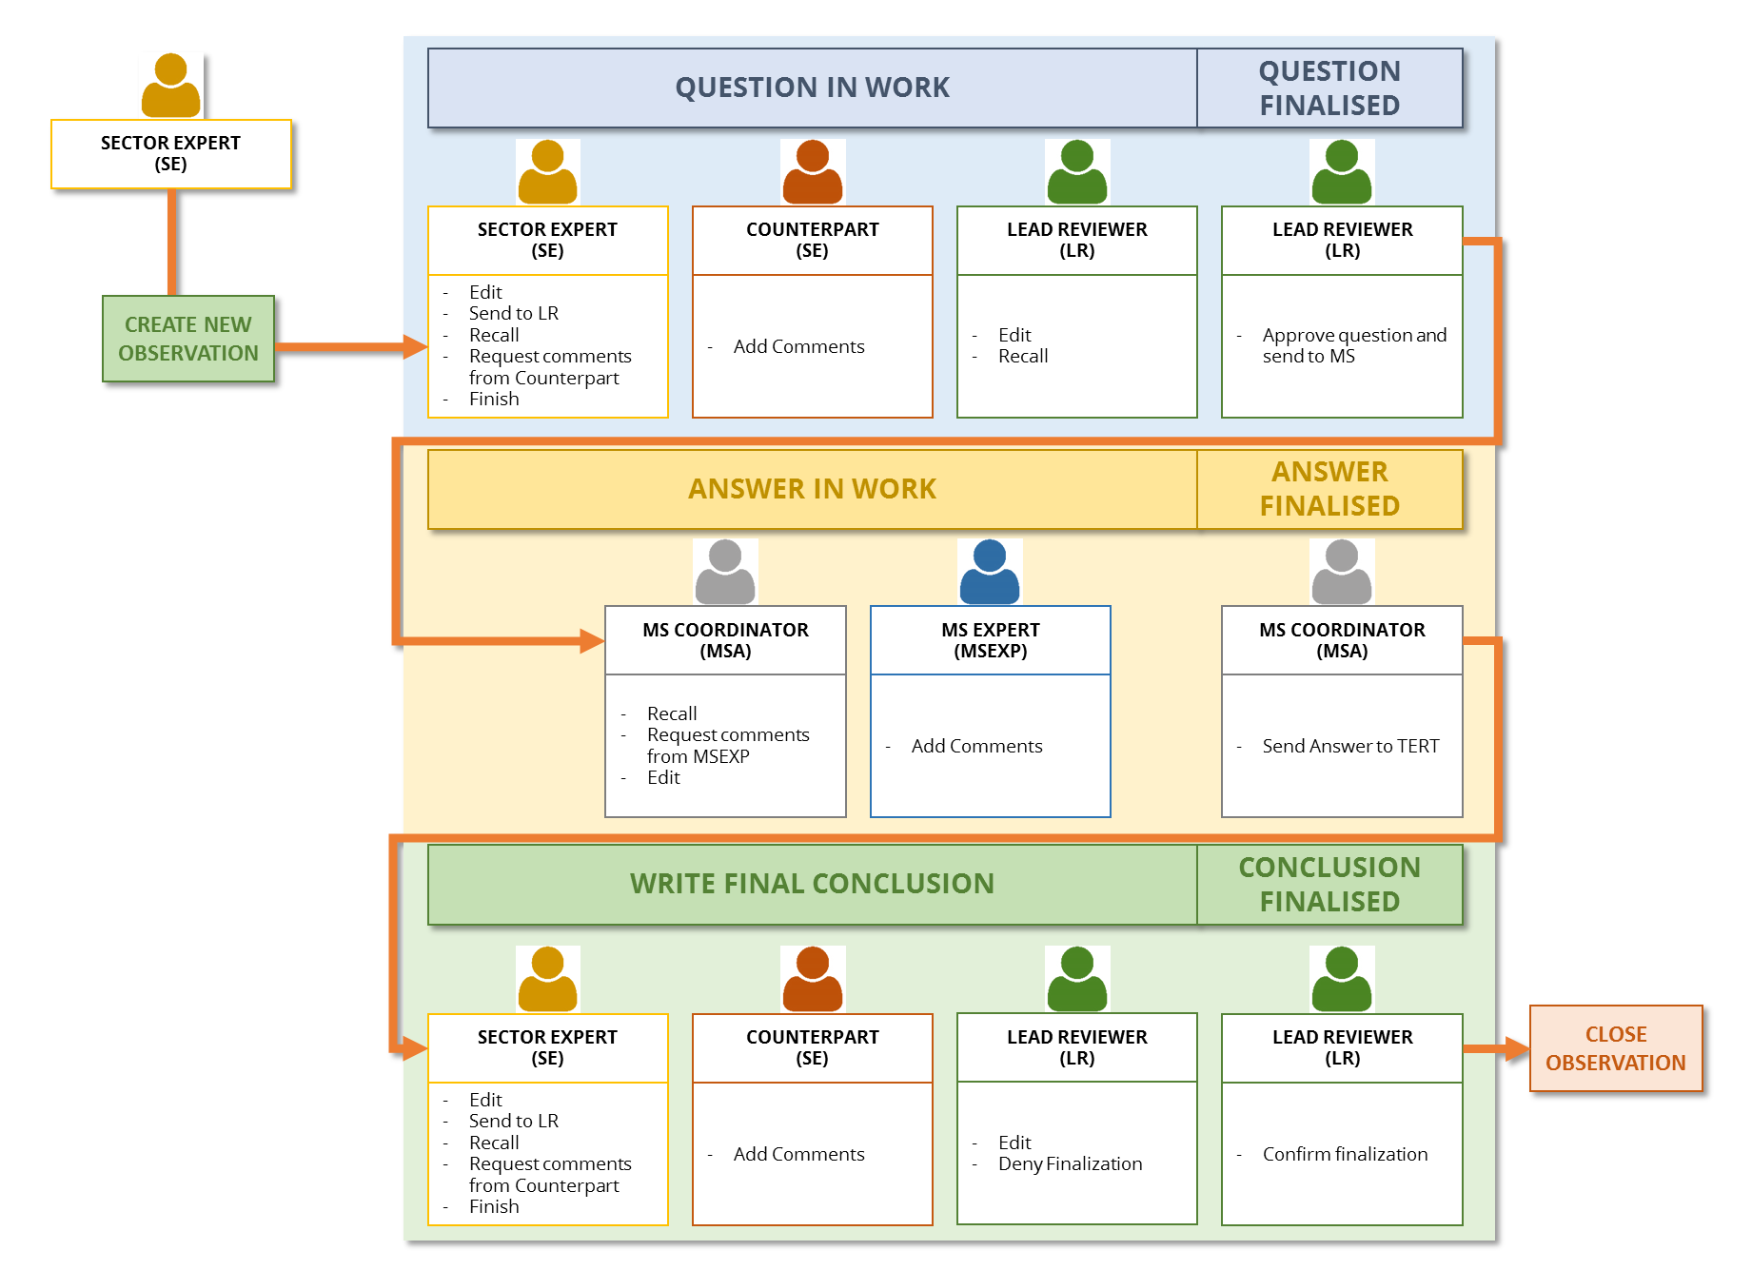
Federico Antognazza | EMRT NECD Training for Member States
EMRT-NECD Review Tool
A tool for communication in the review process under the Revised NEC Directive
Federico Antognazza European Environment Agency
Project Manager: Air pollutant emission mitigation
Mail: federico.antognazza@eea.europa.eu

Slide 2
EMRT-NECD Review Tool
Table of Contents
Introduction to the EMRT-NECD Review Tool
Workflow overview
Log in, My View and user’s tools
Q&A

Slide 3
EMRT-NECD Review Tool
IT IS
A WEB-BASED TOOL hosted by the EEA TO FACILITATE QUALITY CHECKS AND REVIEWS OF NATIONAL EMISSION INVENTORIES reported by EU Member States under the new National Emission Ceilings Directive
USED BY THE REVIEW TEAM to document the review findings and communicate (question and answers) with Member States
A DEVELOPMENT OF THE EMRT used in the annual greenhouse gases emission inventory review process under the Effort Sharing Decision (ESD)
IT IS NOT
a data server in order to access air emission inventory data
a tool created to perform recalculation or revised estimates

Slide 4
EMRT-NECD Review Tool
http://emrt-necd.eionet.europa.eu
Same tool as used under the Effort Sharing Decision (ESD) annual review process
Simplified structure
Transparent communication within Review Team and Member State
Fit with the NECD air emission inventory review process

Slide 5
EMRT-NECD Users
EMRT-NECD
Secretariat
Grant roles and access to EMRT-NECD
Helpdesk
QA/QC of the review tool performance
SECRETARIAT
(SEC)
Start the Review Process
Add Observation and request comment
Send Observation (and conclusion) to LR
SECTOR EXPERT
(SE)
Technical Expert
Review Team
(TERTs)
Is a Sector Expert
Help the main Sector Expert by adding comment (4 eyes principle)
COUNTERPART
(SE)
Comment inside Observation
Forward Observation with question to MS
Confirm (deny) finalization of an observation
LEAD REVIEWER
(LR)
MS COORDINATOR
(MSA)
Get request for Answer from Lead Reviewer
Send answer to Sector Expert (TERT)
Member States
Review Team
MS EXPERT
(MSEXP)
Comment inside a request for answer to help MSA work

Slide 6
ERMT-NECD General Workflow

Slide 7
EMRT-NECD: how does the workflow work?
SE
SE
SE
SE
SE
LR
Ask To
Redraft
Go To
Conclusions
New
Observation
Add
Question
Request
Comment
Close
Comment
Send for
Approval
Request
Answer
C-SE
LR
MSA
MSA
SE
SE
SE
Reply
Comment
Request
Comment
Reply to
Answer
Get the
Answer
Add
Conclusion
Request
Finalization
MSEXP
Add
Question
Respond to
Comment
LR
Deny
Finalization
Confirm
Finalization
Resolved
Resolved
Not Sent to MS
Resolved
Recommendation
Resolved
Recommendation
Resolved
Note
Unresolved
Recommendation
Unresolved
Recommendation
Resolved
Recommendation
Revised Estimate
Tech. Correction
Tech. Correction

Slide 8
EMRT-NECD: Privacy
ONLY the FINAL QUESTION with the request for an answer will be visible to Member State
internal comment looping between the TERT experts will be not visible to Member State
ONLY the FINAL ANSWER, sent by the MS, will be visible to the TERT
internal comment looping between MS experts will be not visible to the TERT

Slide 9
EMRT-NECD: how to login
In order to log in the EMRT-NECD, users have to use their own EIONET ID
Only users listed on the extranet-necd-review can log in
EIONET ID has been sent by email to new users
Information in order to reset password are provided in the EMRT-NECD home page

Slide 10
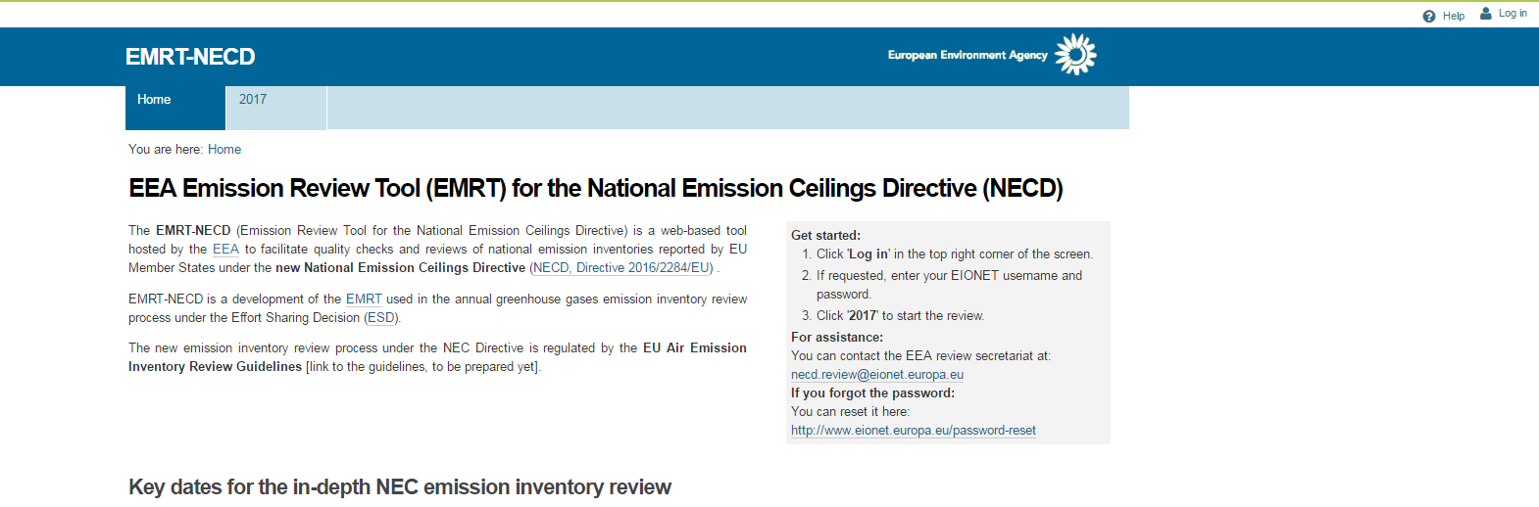
EMRT-NECD: login procedure

Slide 11
EMRT-NECD: “My View” menu
Lead Reviewer
My Action
Questions to be sent
Observations to finalise
Questions to comment
My Team’s Actions
Questions with comments for reviewers
Answers from MS
My MS’ actions
Unanswered questions
Sector Expert
My Actions
Draft questions
Counterpart questions to comment
Counterpart conclusions to comment
MS answers to review
Other actions for my observations
Observation for approval
Unanswered questions
Waiting for comment from counter parts for question
Waiting for comment from counter parts for conclusion
Observation for finalisation
Member State Coordinator
My actions
Questions from Sector Expert to be answerer
Comments received from MS experts
MS experts actions
Answers requiring comment/discussion from MS experts
Sector Expert actions
Answers sent to Sector Expert
Member State Expert
My actions
Comments for answer needed by MS coordinator
MSC actions
Observations with my comments still with MSC
Sector Expert actions
Answers that I commented on sent to Sector Expert

Slide 12
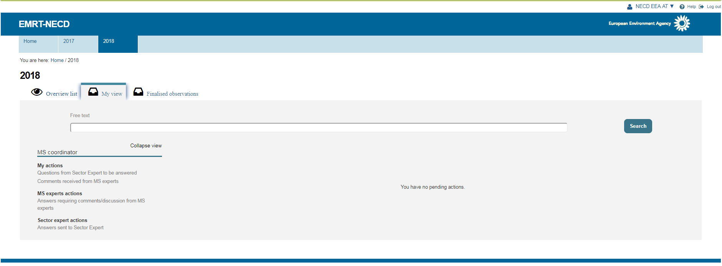
EMRT-NECD: new “My View” appearance
Member State Coordinator

Slide 13
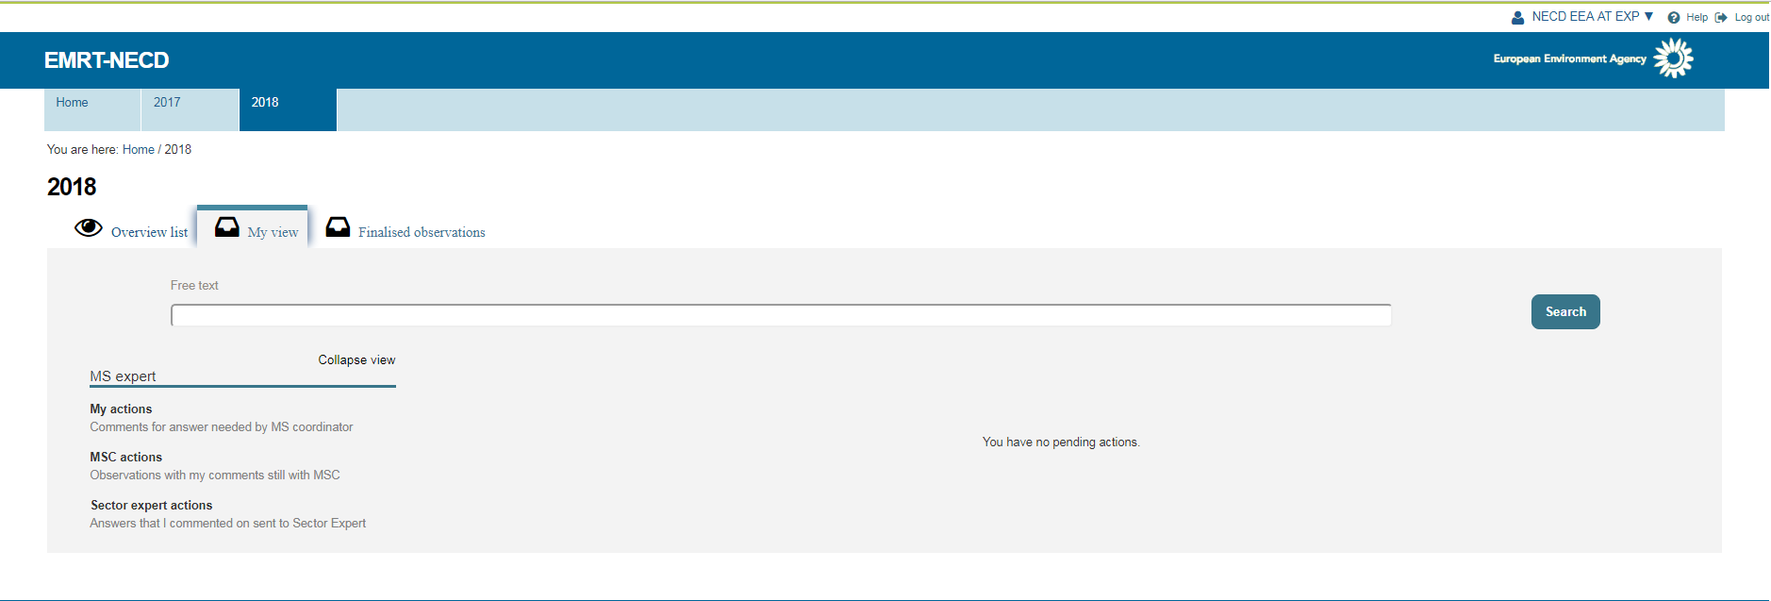
EMRT-NECD: new “My View” appearance
Member State Expert

Slide 14
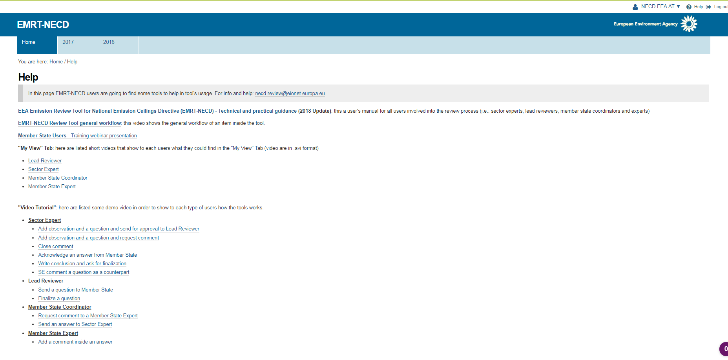
EMRT-NECD: Help page

